Slide 1

ROUND 1 STRATEGIC BLUEPRINT
TEAM CIPHER CODERS • ISHAAN RAY & RISHI PRAJAPATI
PROBLEM STATEMENT
BrandSphere AI
Intelligent Pre-Publication Brand Governance
Enterprise Trust Framework
•
Autonomous Content Control
INKLOOM AI
01 / STRATEGY

Slide 2

THE HIDDEN THREAT OF BRAND ENTROPY
The Core Conflict & Crisis
01 / CLAIMS
02 / TONE
High-velocity content creation without robust
guardrails leads to severe brand entropy and
credibility risks.
Unsupported Promotional Claims
Messaging & Tone Drift
Unverified statements entering public channels
without validation.
Inconsistent voice across decentralized
authoring units.
Organizations deploy internal authors, external agencies, and
generative AI tools, producing massive content across web, social,
PR, and collateral.
03 / DESIGN
04 / DATA
Visual & Design Discord
Outdated Facts
Aesthetic divergence and accessibility (WCAG)
violations.
Stale statistics and deprecated information
persisting in collateral.
ANALYSIS OF FRICTION PILLARS AND CREDIBILITY RISK METRICS
SEC-01

Slide 3

MULTI-STAKEHOLDER ENTERPRISE ALIGNMENT
Target Users & Market Persona Matrix
Tailored workflows designed for creators, managers, agencies, and
executives to ensure seamless collaboration.
PERSONA 01
PERSONA 02
Content Creators & Copywriters
Brand & Compliance Managers
Need rapid feedback without waiting days for legal signoff, enabling
frictionless creative iteration.
Need total visibility into upcoming releases and complete auditable trails to
mitigate regulatory risk.
PERSONA 03
PERSONA 04
Agencies & External Partners
Executive Leadership
Need clear boundary guidelines and automated compliance checks to deliver
on-brand assets efficiently.
Need quantitative visibility into overall brand health, velocity metrics, and
enterprise risk exposure.
4-quadrant persona grid mapping critical friction points, daily goals, and direct value unlocks.
Ecosystem Synchronized

Slide 4

INTELLIGENT PRE-PUBLICATION BRAND GOVERNANCE
The Proposed Solution: BrandSphere AI
Explainable AI Citations
Points directly to approved guidelines and canonical references with total clarity and
trust.
CORE ARCHITECTURAL VISION
A continuous, intelligent brand-
governance copilot validating content
before publication against guidelines and
canonical truth.
Context-Preserving Remediation
Generates intelligent remediation suggestions tailored to maintain original brand
voice and tone.
Hero split layout demonstrating core platform value and
interactive preview workflows.
Human-in-the-Loop Sovereignty
Automated assistance accelerates decisions while final authority remains strictly
with authorized reviewers.
BrandSphere AI Architecture
Enterprise Platform Overview

Slide 5

SYSTEM ARCHITECTURE
4-STAGE END-TO-END PIPELINE
End-to-End Product Workflow
A seamless 4-step pipeline ensuring rigorous compliance without slowing down content
velocity.
01
02
03
04
Universal Multi-
Modal Ingestion
Multi-Dimensional
Policy & Fact Engine
Explainable
Resolution & Review
Certified Publication
& Analytics
Captures and standardizes diverse data
streams and multi-format assets at
scale prior to processing.
Applies rigorous automated checks,
validating factual accuracy against
enterprise compliance policies.
Facilitates transparent human-in-the-
loop collaborative review with clear
resolution paths.
Certified publication featuring
cryptographic verification and real-time
governance telemetry.
PIPELINE STATUS: OPTIMAL
SECURE FLOW • END-TO-END AUDITABLE

Slide 6
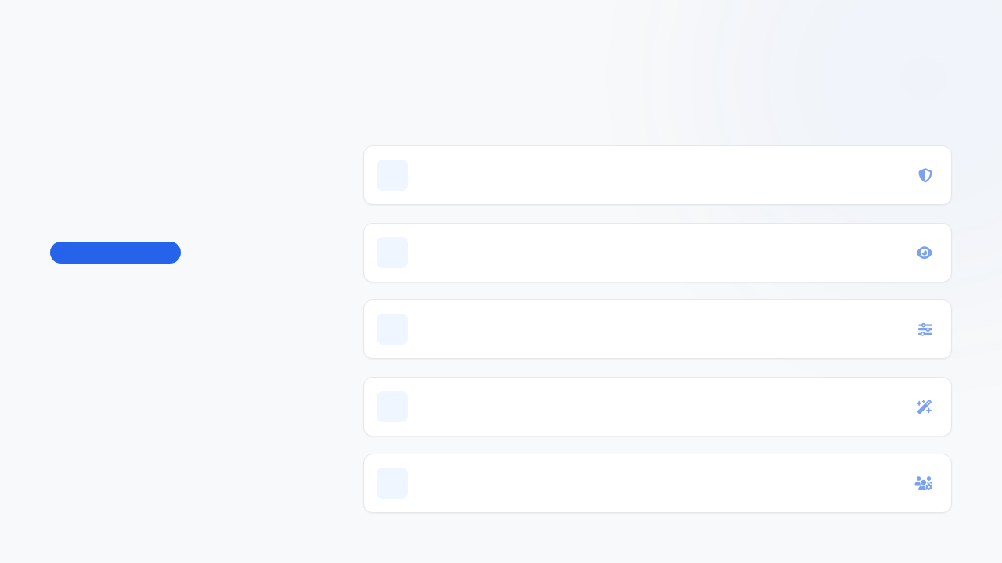
ARCHITECTURAL DEEP DIVE
Core Capabilities
Deep Dive: Core Capabilities
01
Fact-Checking & Unsupported Claim Guard
Automated verification against grounded knowledge bases.
System Architecture
02
Multi-Modal Visual & Accessibility Auditor
Real-time analysis of layout contrast, hierarchy, and compliance.
Five pillars powering
automated precision.
03
Tone & Terminology Harmonizer
Ensures brand voice consistency and precise linguistic style.
Five core architectural pillars powering automated
fact-checking, visual auditing, and collaborative
review. Designed for high-integrity workflows and
enterprise scale.
04
Intelligent Suggestion & Auto-Remediation
Proactive fixes for detected discrepancies and formatting flaws.
05
Collaborative Multi-Tier Approvals
Role-based access control and streamlined multi-stage review gates.

Slide 7

ENTERPRISE SYSTEM ARCHITECTURE
MODULAR STACK V2.4
Technical Architecture & System Design
Built on a high-throughput, secure, and modular technology stack designed for
enterprise-grade reliability.
01
Frontend Layer
Next.js 14
React
Tailwind CSS
ARCHITECTURE BLUEPRINT
Responsive client interface & reactive rendering engine.
Layered Stack Paradigm
The architecture enforces strict separation of concerns
across four decoupled tiers, ensuring horizontal
scalability, fault isolation, and zero-trust security
compliance.
02
API & Orchestration Layer
FastAPI
Celery
Redis
High-concurrency routing, asynchronous task queues & caching.
99.99%
< 45ms
AI & RAG Intelligence Engine
03
Qdrant Vector
DB
Hybrid
Retrieval
Multimodal LLM
Target Uptime SLA
P99 API Latency
Vector similarity search, hybrid context retrieval & LLM
orchestration.
All tiers communicate via authenticated,
encrypted binary protocols.
04
Security & Privacy Boundary
Zero-Data-Retention
TLS 1.3
SOC 2
Zero-data-retention pipelines, transit encryption & audit
compliance.
SYSTEM HEALTH: OPTIMAL
|
SECURE PIPELINE ACTIVE
ENTERPRISE INFRASTRUCTURE SPECIFICATION

Slide 8

DIFFERENTIATED MARKET POSITIONING
Originality & Competitive Edge
GRAMMAR CHECKERS
STANDARD LLMS
Grammarly & Similar
Generic Prompts
BrandSphere AI bridges the gap between
superficial grammar tools and unreliable generic
LLMs with grounded enterprise intelligence.
Superficial grammar and stylistic tweaks without
enterprise context or brand grounding.
Unreliable outputs prone to hallucinations with
zero verifiable guideline citations.
ENTERPRISE STANDARD
BrandSphere AI
Side-by-side comparison matrix and Guideline Clarity Index
overview.
Grounded RAG Accuracy & Multimodal Verification
Delivers explainable guideline citations and continuous telemetry via the Guideline Clarity Index, ensuring
absolute brand compliance and originality.
BrandSphere AI Intelligence Suite
Guideline Clarity Index Overview

Slide 9

TEAM CIPHER CODERS
OWNERSHIP MATRIX
Team Roles & Ownership Matrix
Clear division of domain ownership combining deep AI systems expertise with full-stack execution capability.
TEAM LEADER
CORE ENGINEERING
Ishaan Ray
Rishi Prajapati
AI System Architecture
Full-Stack Web Architecture
RAG Pipeline Design
User Experience & Interface Design
Evaluation & Hallucination Mitigation
Collaborative Review Engine
Prompt Engineering
Governance Dashboard & Integrations
CIPHER CODERS CORE DOMAIN MAPPING
SECURE ARCHITECTURE & EXECUTION

Slide 10

MILESTONE ROADMAP & FEASIBILITY
3-Round Execution
Roadmap & Feasibility
A phased, risk-mitigated execution roadmap ensuring robust
delivery across all competition stages.
ROUND 1
01
ROUND 2
02
ROUND 3
03
The Plan
The Build
The Finish
Complete system design and rigorous RAG
retrieval schema establishment to lay the
architectural foundation.
Functional end-to-end prototype
development featuring automated text &
image scanning alongside comprehensive
UI reviews.
Enterprise hardening, batch document
upload capabilities, analytics dashboard
integration, and rigorous stress testing.
Architecture & Blueprint
Prototype & Validation
Hardening & Launch
Gantt-style milestone timeline & deliverables
FEASIBILITY ROADMAP

Slide 11

MEASURABLE IMPACT & FUTURE SCOPE
Projected Impact & Future Horizon
FUTURE SCOPE
MEASURABLE IMPACT
Seamless ecosystem expansion & platform interoperability.
Delivering enterprise efficiency and uncompromised compliance.
Slack
Figma
80%
99.5%
100%
Canva
Google Docs
Reduction in content review
cycle time
Elimination of unverified
claims
Audit compliance achieved
HubSpot
WordPress
Enterprise Efficiency & Ecosystem Roadmap
Aura Visual Strategy

Slide 12

CONCLUSION & CALL TO ACTION
INKLOOM AI — ROUND 1 SUBMISSION
In an era where AI accelerates content
volume by 100x, BrandSphere AI provides the
essential steering wheel and safety system.
Team CIPHER CODERS pledge: Building a platform that balances machine speed
with human taste, protecting company reputation at every touchpoint.
TEAM CIPHER CODERS
Protecting Enterprise Reputation at Every Touchpoint
END OF PRESENTATION

